Slide 1
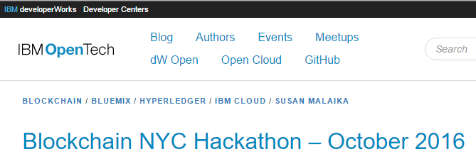
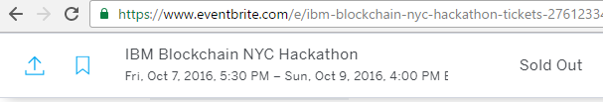
Spreadsheet Team
@spreadblock.slack.com
Jsev (Jeremy), tmenner@gmail.com (Tom), @gregmisiorek (Greg), Johnnyy, mike (Anhmike), Rajesh, Nastia

Slide 2
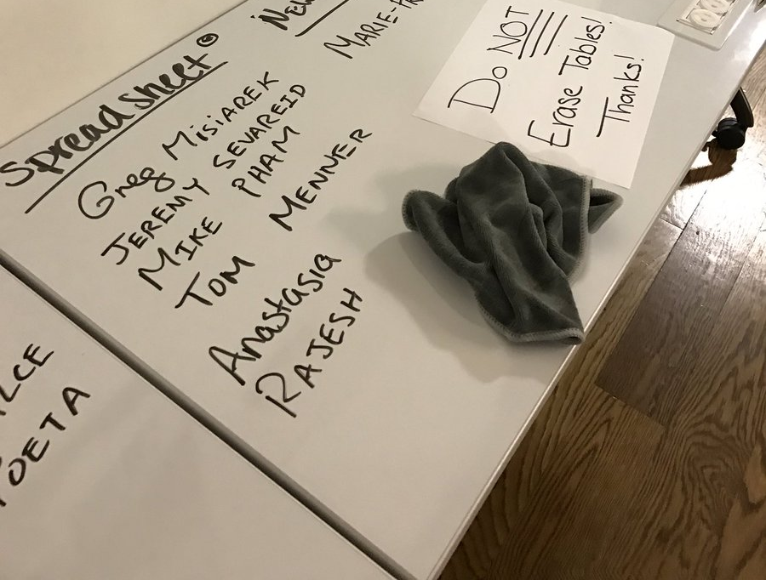
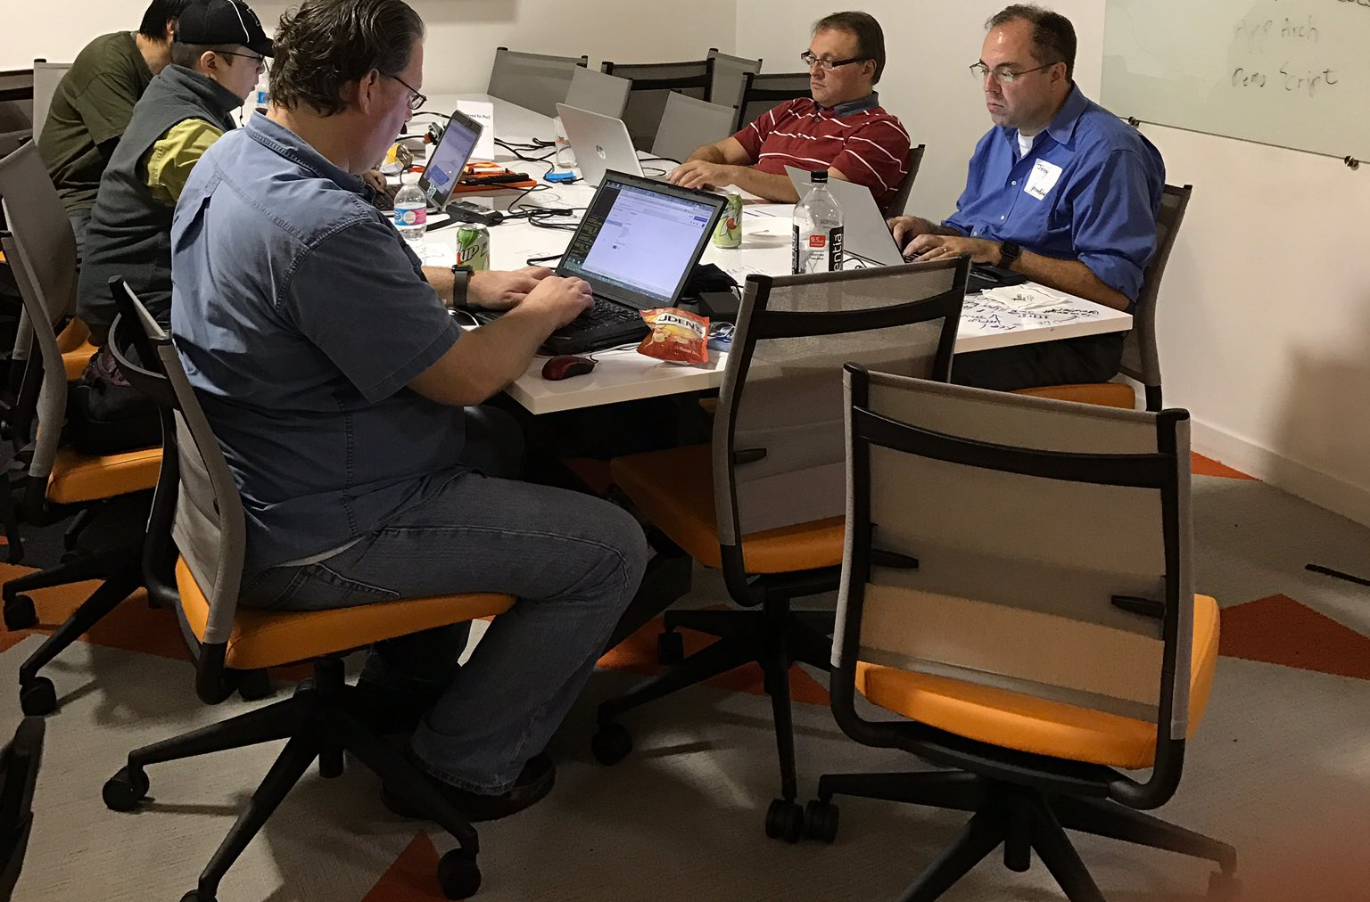
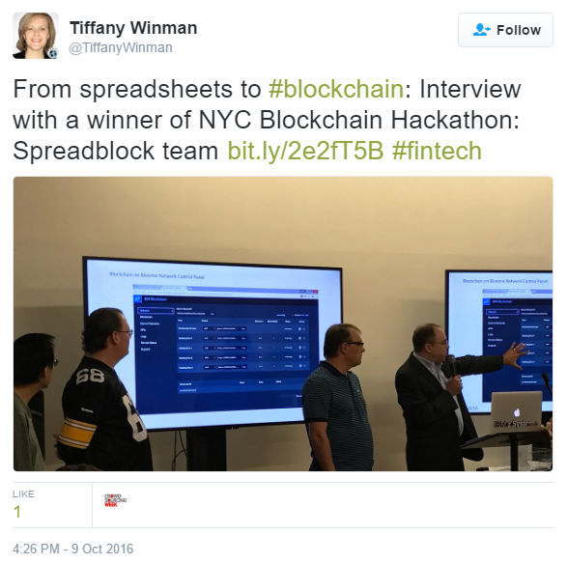
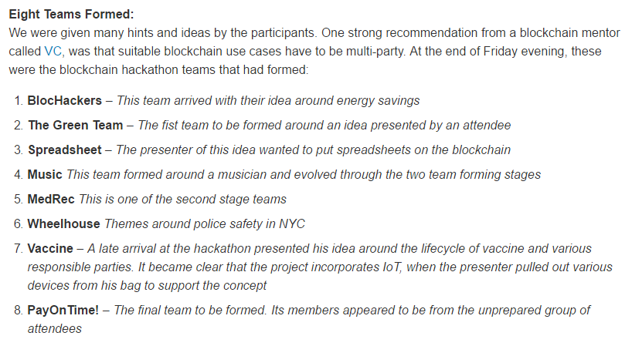
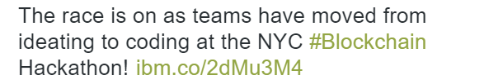
Three days in October at the IBM Blockchain NYC Hackathon at Galvanize in Soho
Friday Night
Saturday
Sunday
Day One Blog
https://wp.me/p6tTze-1TY
Day Two Blog
http://t.co/B30clNzRKK
Day Three Blog
https://developer.ibm.com/opentech/2016/10/10/ibm-blockchain-hackathon-nyc-the-winning-teams/
Facebook Live Interview
https://www.facebook.com/tiffany.winman/videos/10154467457531236/
10/9/16

Slide 3

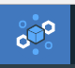
HTTP
REST-ful API
Excel
Hyperledger
On Bluemix
10/9/16

Slide 4

On Desktop, Spreadsheet as
  GUI
  Financial Model
  Report Writer
  Exception Manager
  Chain Admin
Hyperledger
On Bluemix
In Cloud, Spreadsheet as
  Financial Model
  Calc Engine
  Data Source
  Oracle
Hyperledger in Bluemix
  Financial Transactions
    E.g., Commercial Paper Demo
  Shared Data
10/9/16

Slide 5
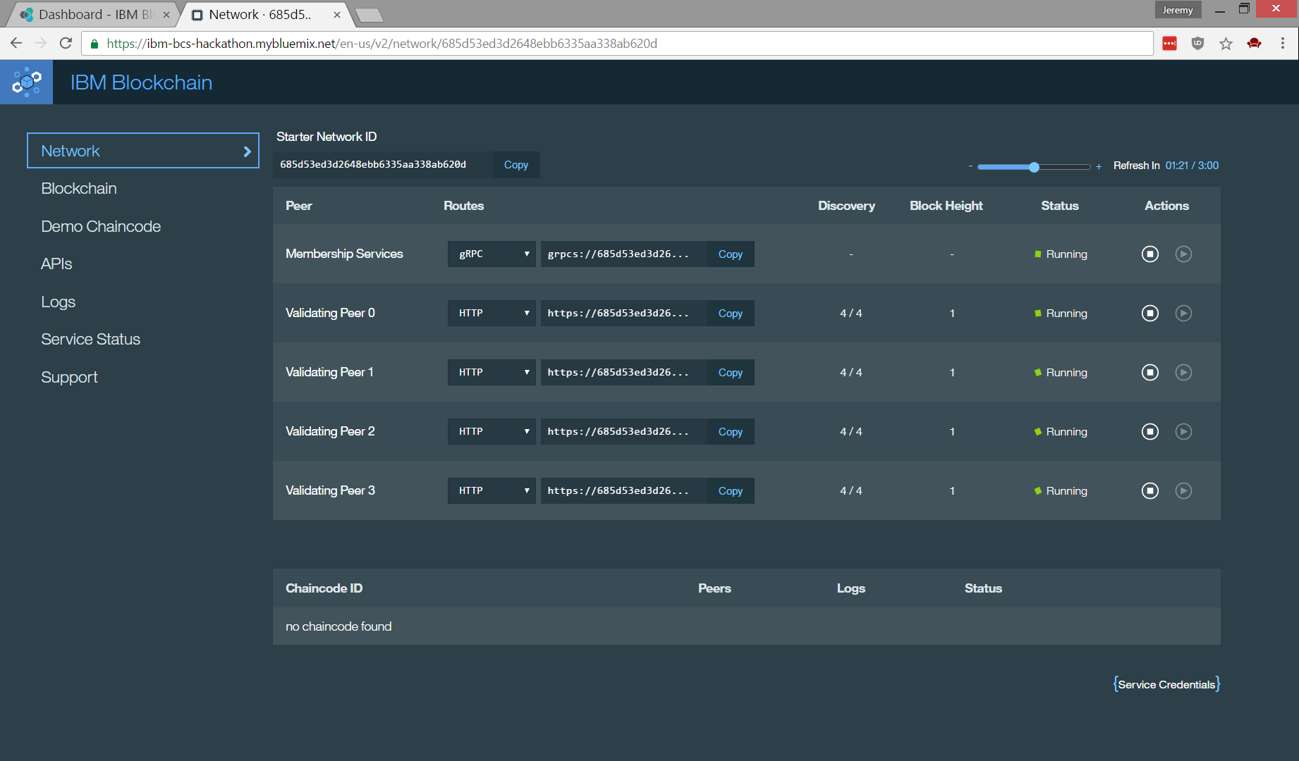
Blockchain on Bluemix Network Control Panel
10/9/16

Slide 6
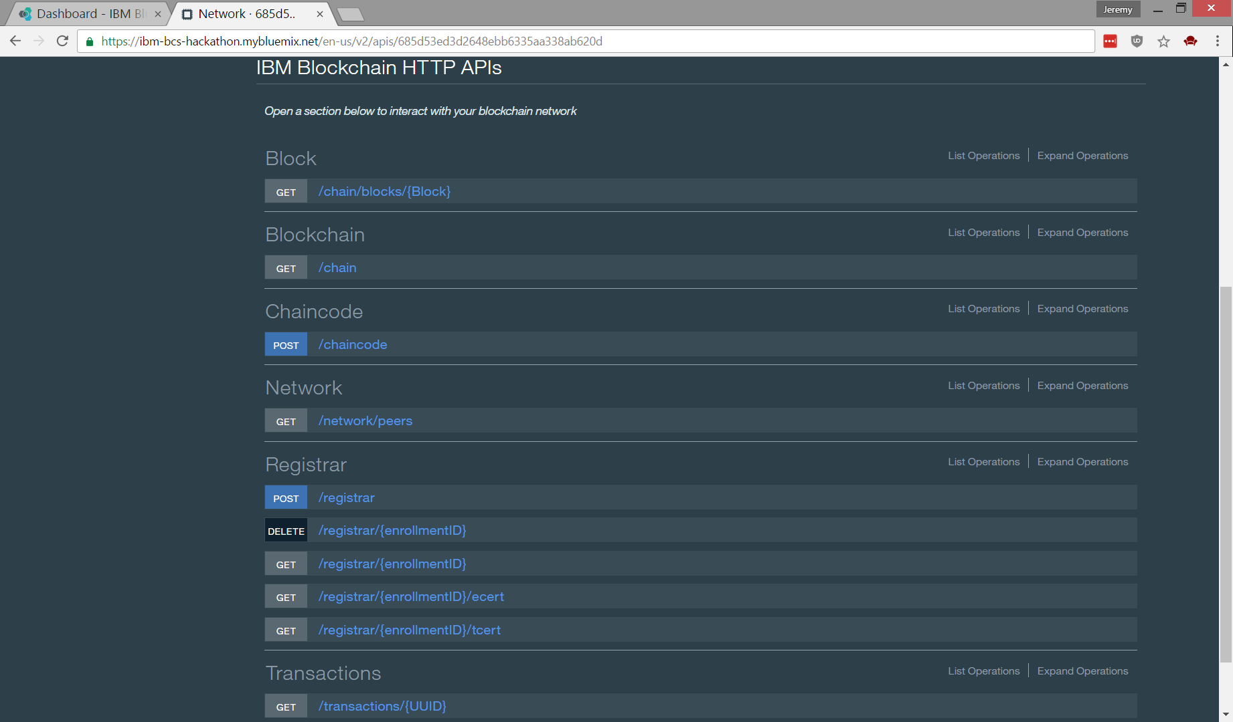
HTTP REST-ful Blockchain APIs
10/9/16

Slide 7
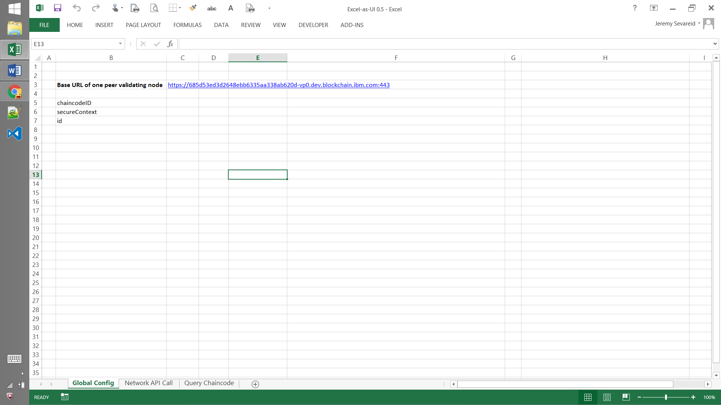
Excel as UI - Point to one of the 4 nodes running in Bluemix
10/9/16

Slide 8
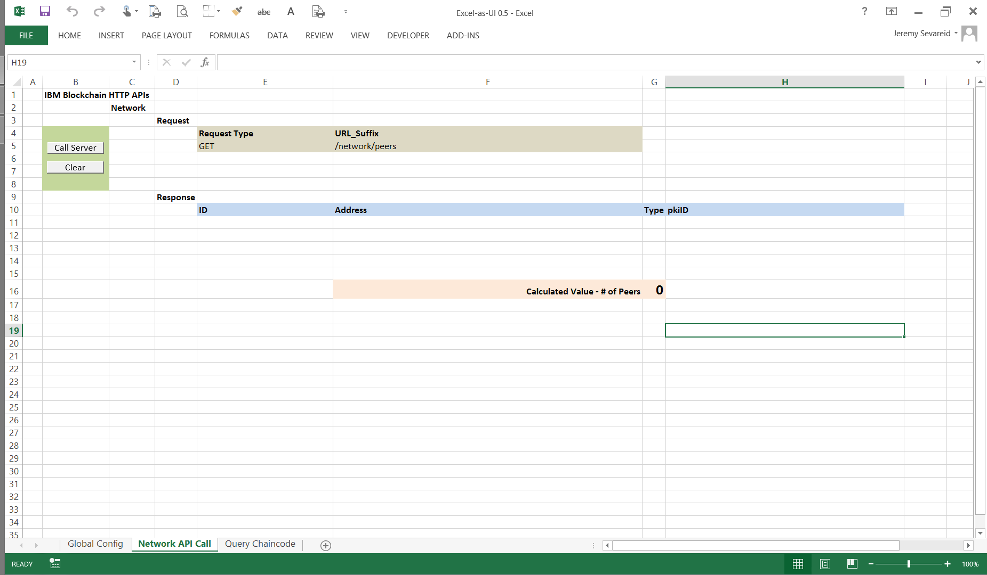
Excel as UI - Before
10/9/16

Slide 9
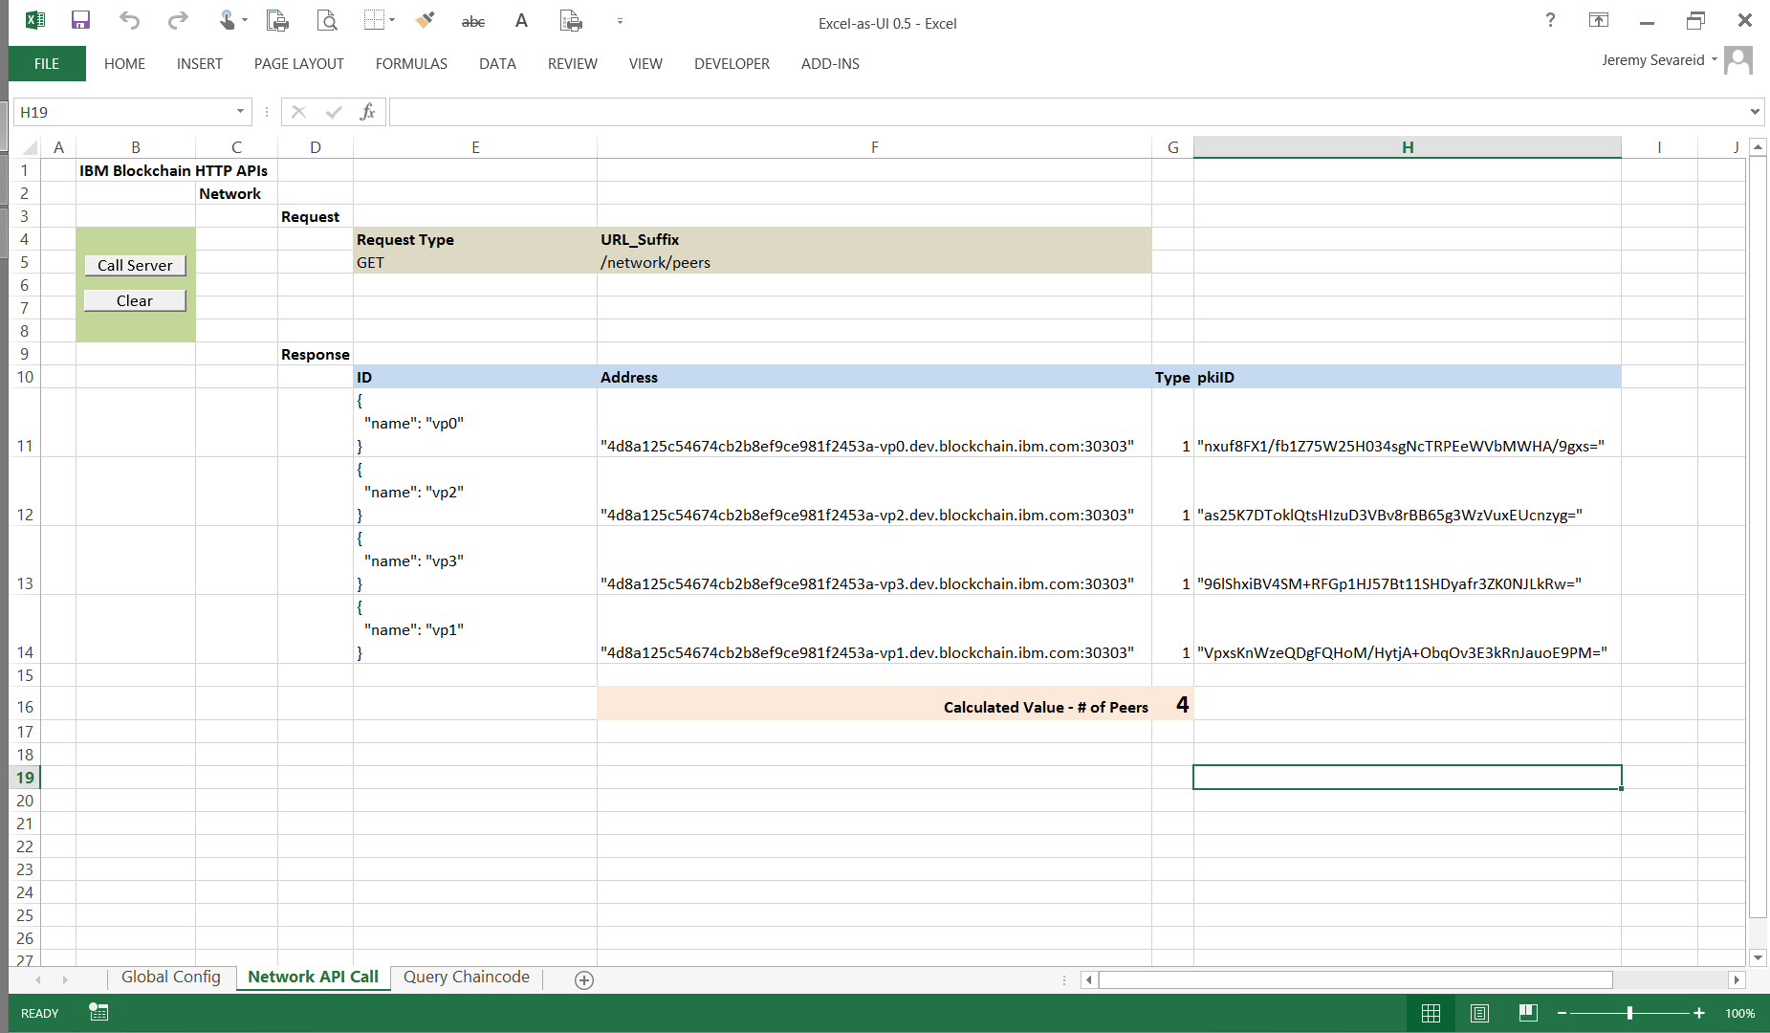
Excel as UI - After
10/9/16

Slide 10
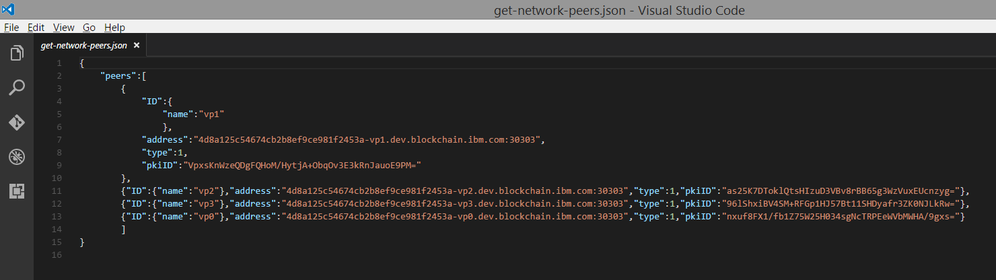
Blockchain peer node responds to HTTP REST-ful query with a JSON payload
10/9/16

Slide 11
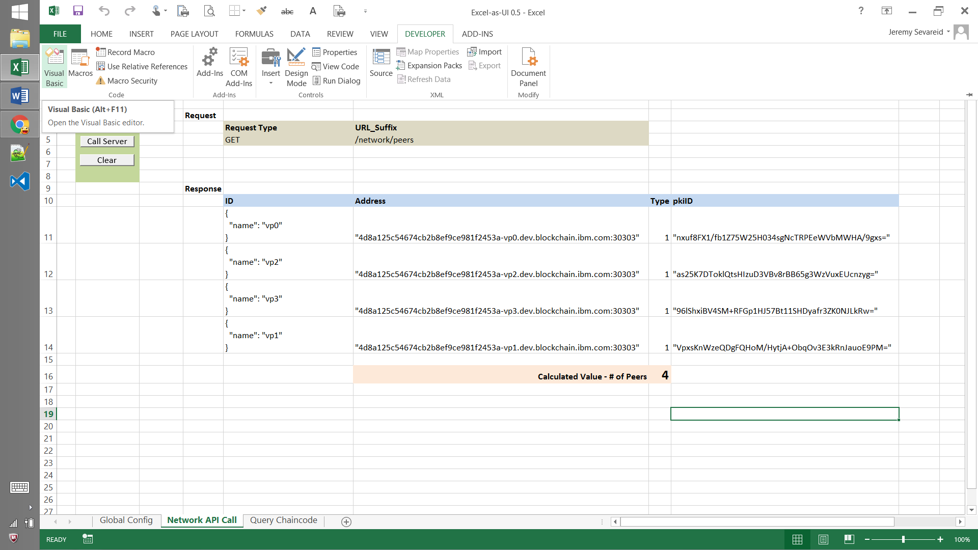
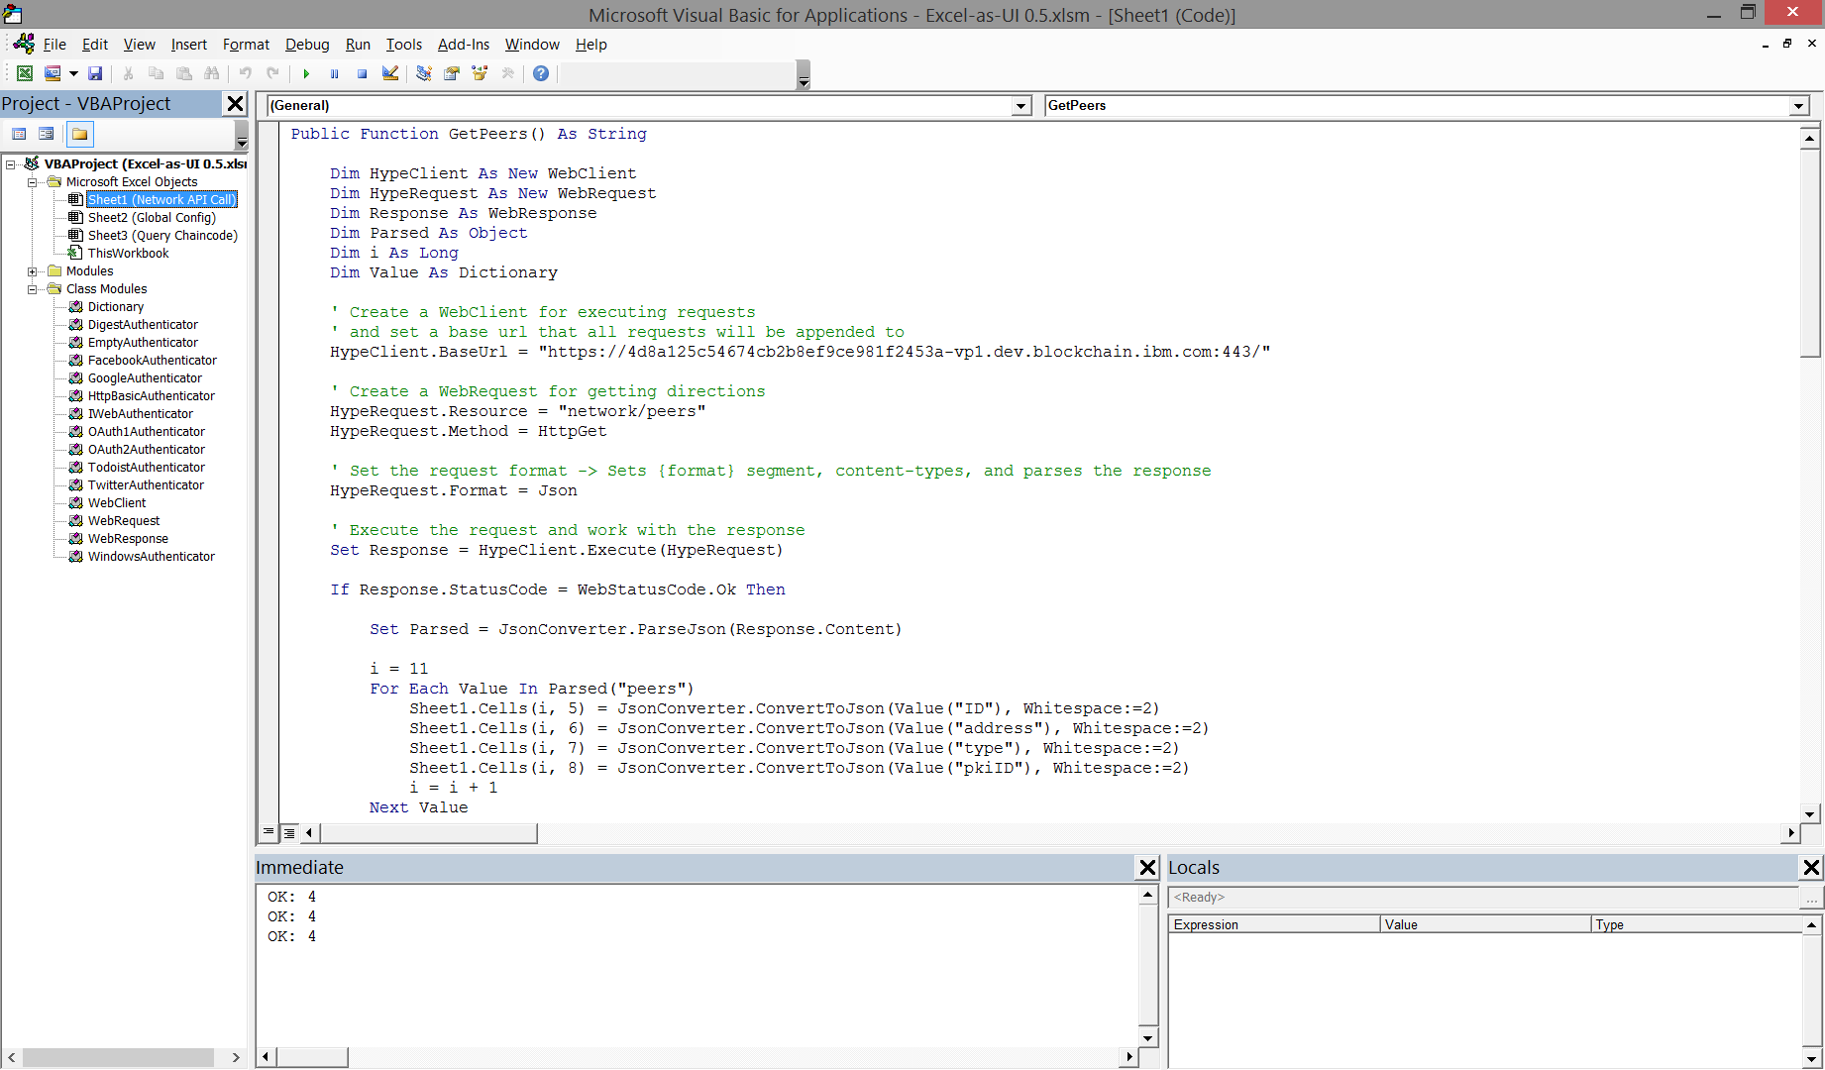
JSON-formatted message payload is parsed and put into spreadsheet cells as structured data
10/9/16

Slide 12
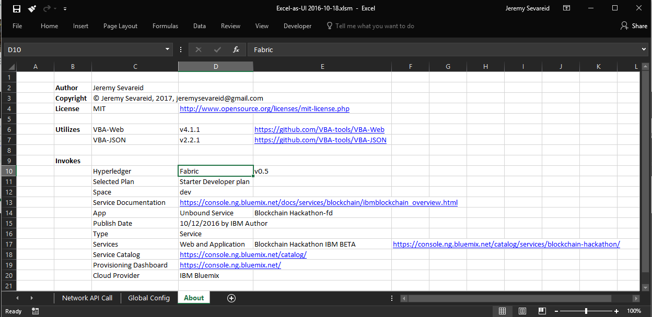
10/9/16

